Slide 1
Cloud Computing Fundamentals
Cloud
Computing
Lecturer: Truong Thi Ngoc Phuong

Slide 2
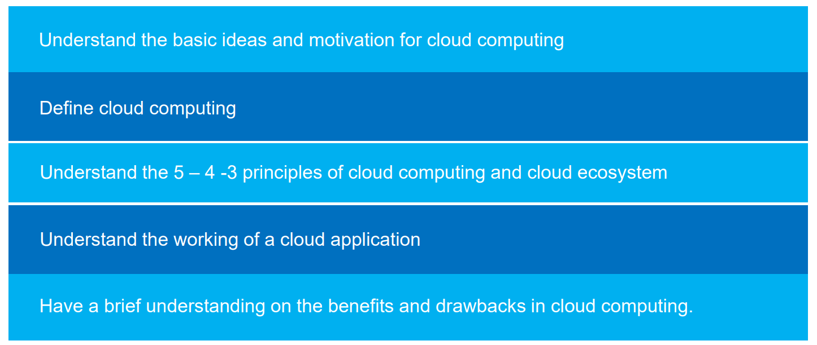
Learning Objectives
For more info:
SLIDESGO | SLIDESGO SCHOOL | FAQS
You can visit our sister projects:
FREEPIK | FLATICON | STORYSET | WEPIK | VIDFY

Slide 3
Table of contents
01
02
03
04
Definition
5-4-3 Principles
Cloud Ecosystem
Requirements for Cloud Services
07
08
Cloud Applications
Benefits & Drawbacks

Slide 4
01
Definition
What is Cloud Computing?
2022

Slide 5
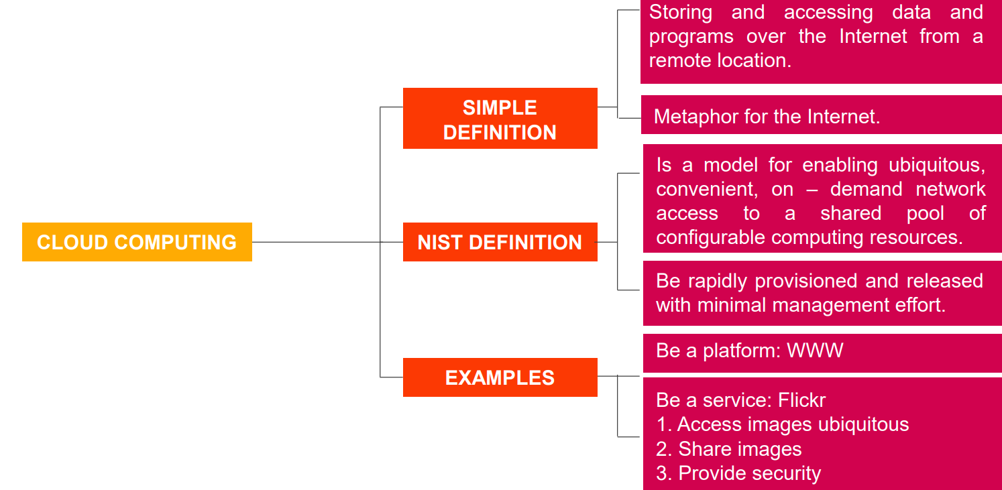

Slide 6
02
5-4-3 Principles
2022

Slide 7
5 characteristics
4
deployment models
CLOUD
COMPUTING
3
Service Models

Slide 8
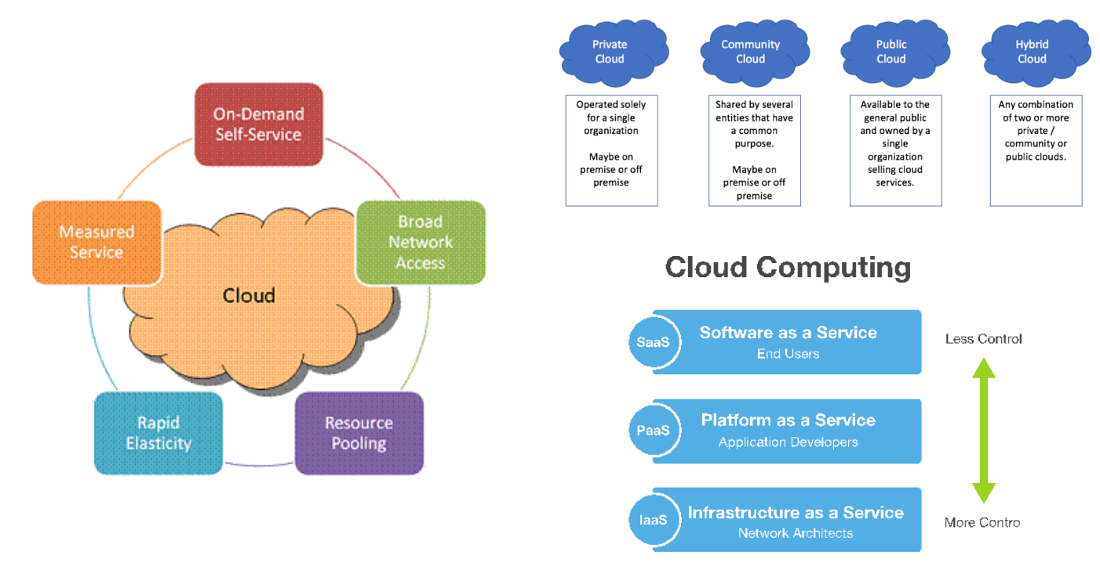

Slide 9
03
Cloud Ecosystem
What is Ecosystem?
2022

Slide 10
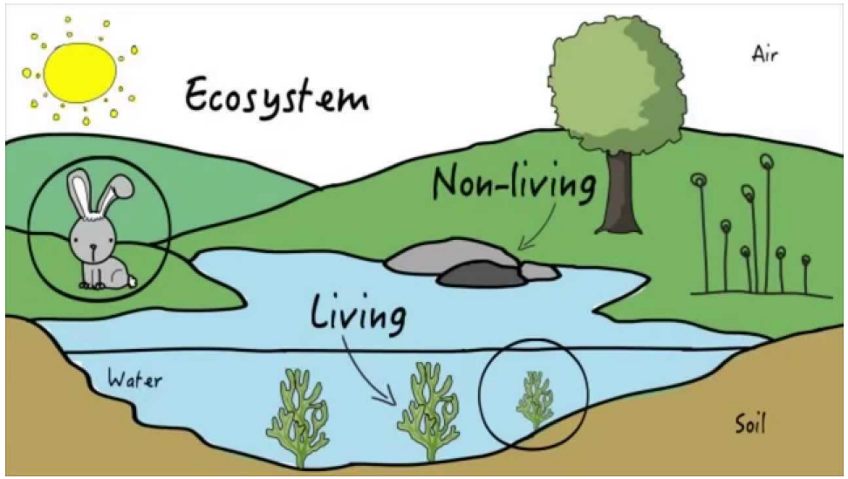

Slide 11
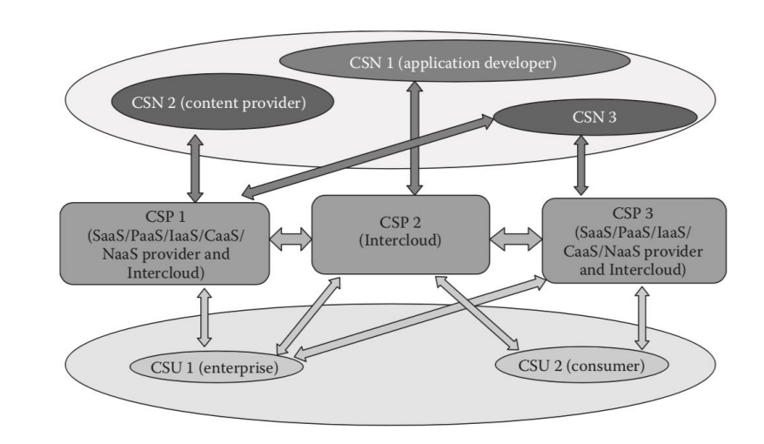

Slide 12

Exercise
Write down roles of Actors in Cloud Ecosystem.
Workshop

Slide 13
04
Requirements for Cloud Services
2022

Slide 14
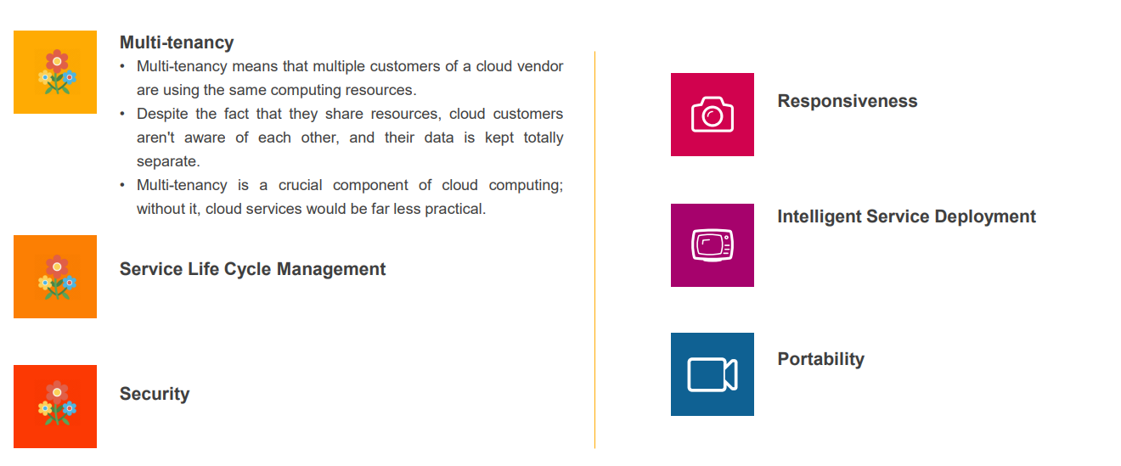

Slide 15
Exercise
Write down definition and samples of these following requirements for cloud services:
Responsiveness
2. Portability
3. Service Life cycle management
4. Responsiveness
.
Workshop

Slide 16
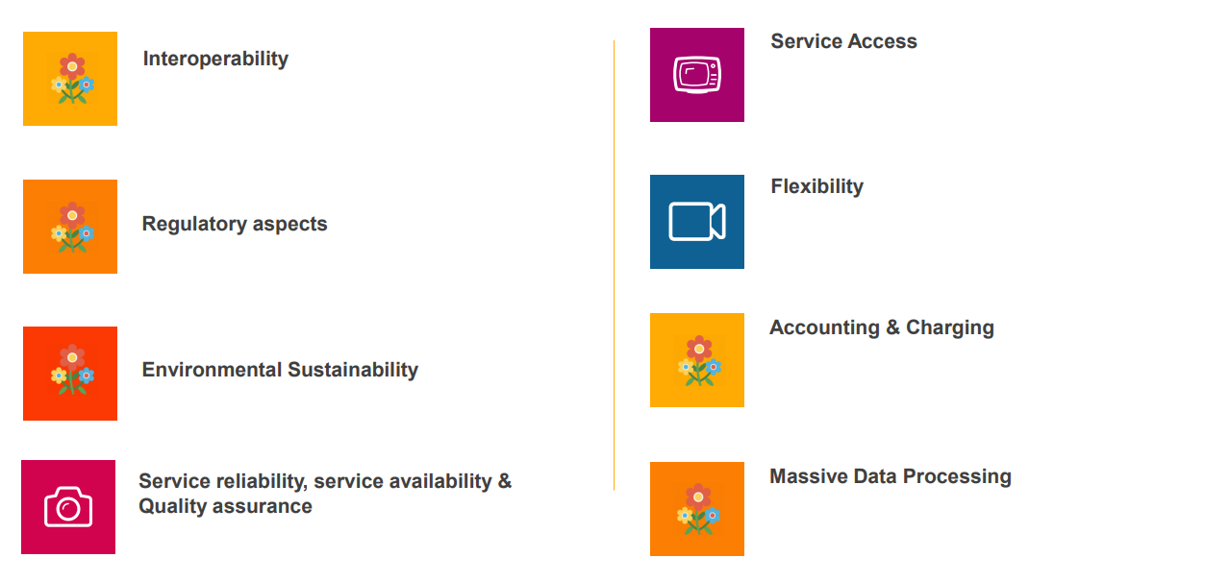

Slide 17
Exercise
Write down definition and samples of these following requirements for cloud services:.
Workshop

Slide 18
05
Cloud Applications
2022

Slide 19
06
Benefits and Drawbacks
2022

Slide 20
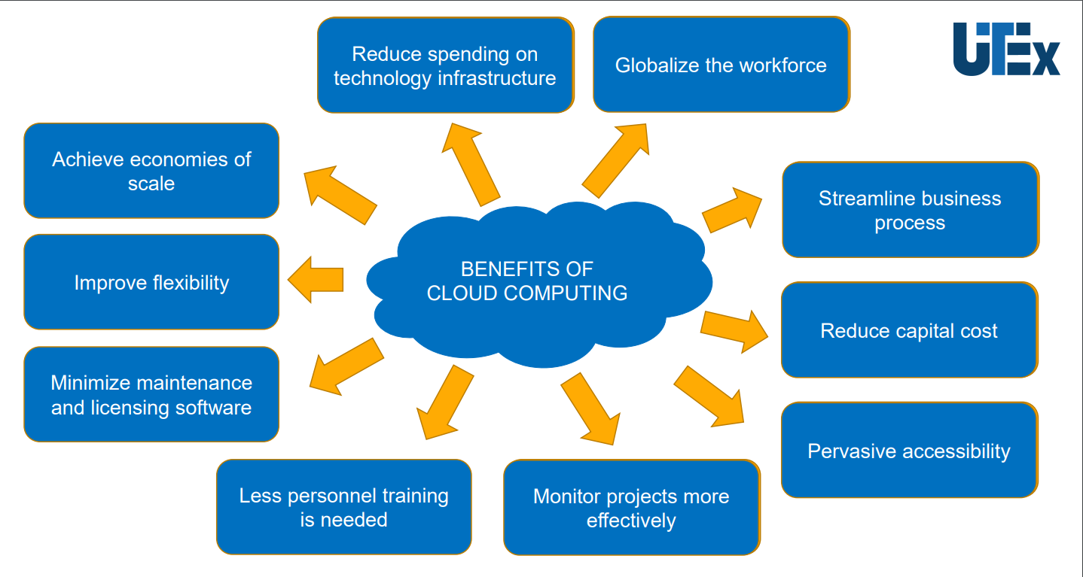

Slide 21
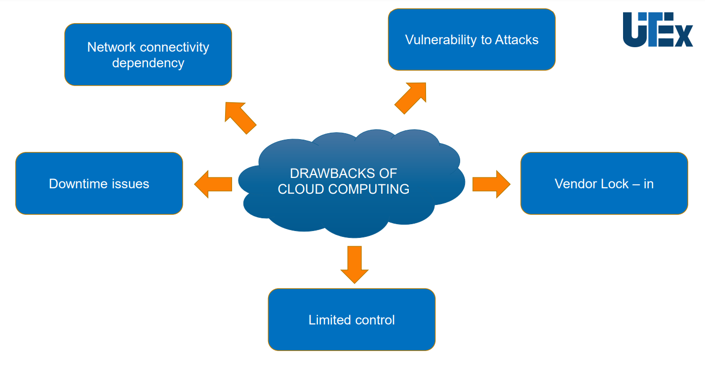

Slide 22
Thanks
If you have any questions,
do not hesitate to email to me at:phuongttn@hcmute.edu.vn

